Slide 1

Serverless Development with Microsoft Azure

Slide 2


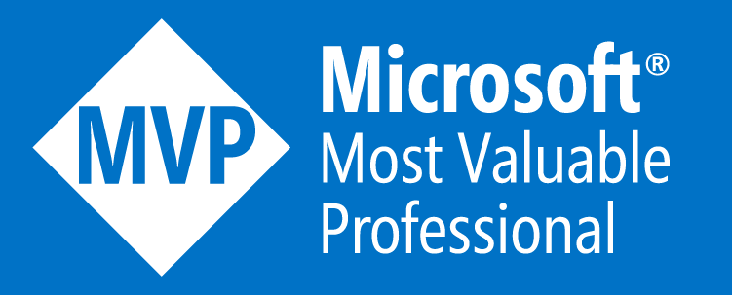


Sam Cogan
Solution Architect – Willis Towers Watson
Microsoft Azure MVP
samcogan.com
@samcogan
sam-cogan

Slide 3
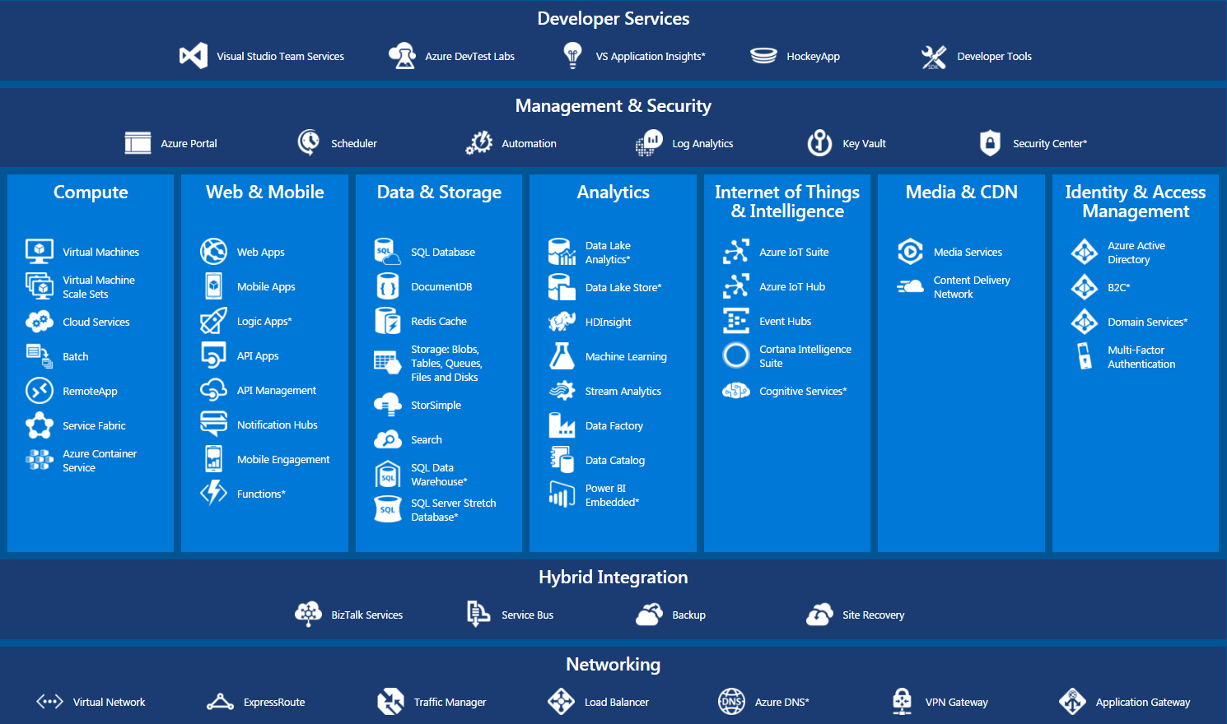

Slide 4
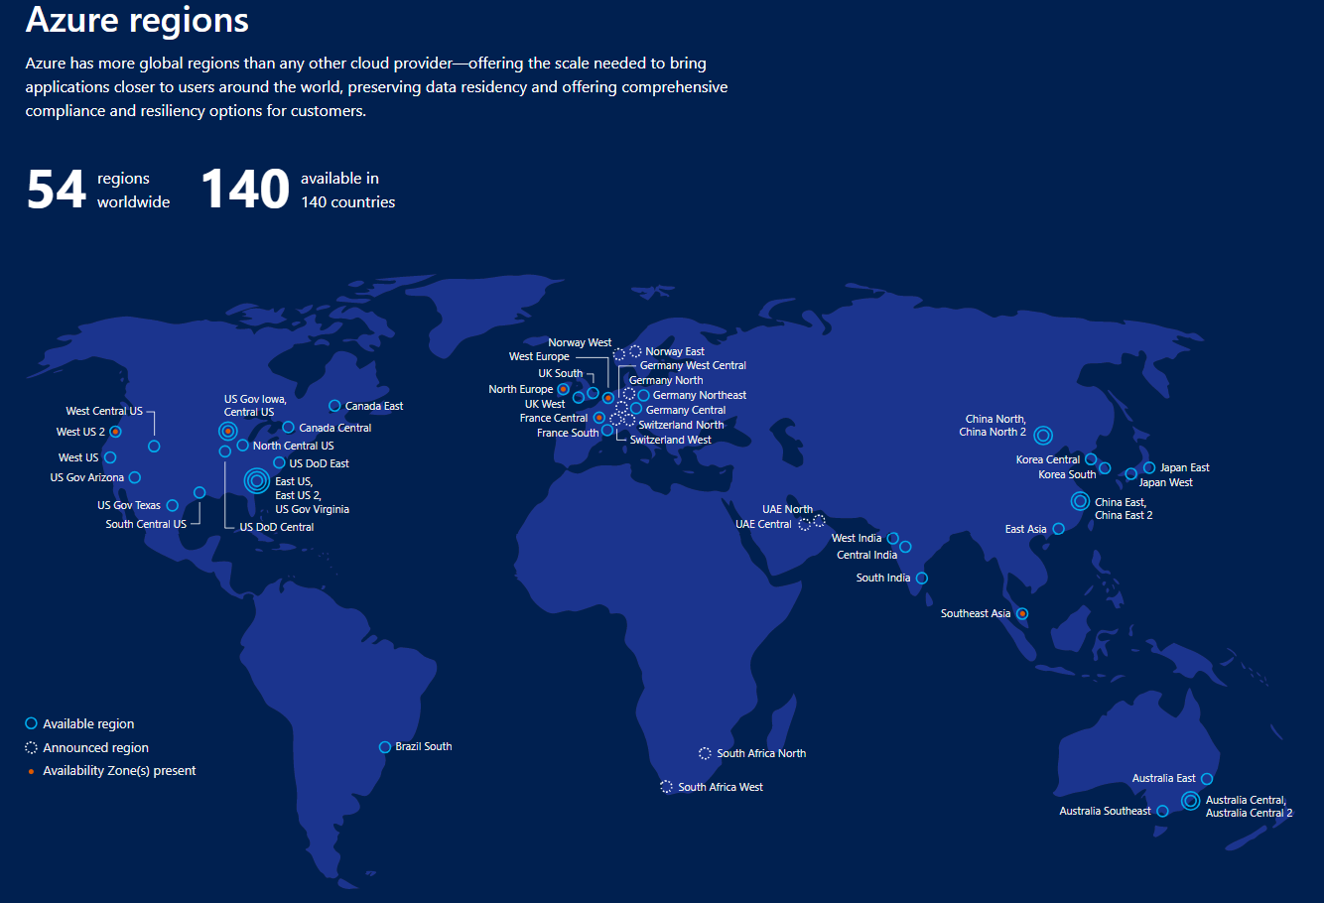

Slide 5
What is Serverless?
How do I architect my app?
On-Premises
IaaS
PaaS
Serverless
The “evolution” of application platforms
Notes:
The latest in this series of evolution is Serverless – which further abstracts the underlying infrastructure from you, and allows you to focus only on a single question – how are you going to build your app to achieve the best results for your business, or whatever it is that you are trying to do with your apps.
Whether it is the code to delight your customers through a great experience, or the logic to communicate securely with a business partner, that is where most organization want to spend their creative energies on.
And serverless allows you to do just that, focus on your code and forget about the infrastructure.
This is why we believe it is the platform for next generation of apps.
Now before we jump into explaining the benefits of serverless, let’s call out what it’s not. It’s not the total lack of servers, that would a bit difficult. Instead, it’s a system where you don’t have to think about Servers at all, so for you, they are invisible.

Slide 6
What is Serverless?
Abstraction of servers
Event-driven scale
Sub-second billing
Notes:
Abstraction of servers, infrastructure and configuration of operating system
Event-driven scale
Sub-second billing
Stateless

Slide 7
Benefits of Serverless
Micro-pricing
Ease of scale
Manage less
Notes:
“Pinnacle of PaaS compute”
Not just hardware “servers”, but software servers are also managed for you
Focus on business logic, not solving technical problems not core to business
Lower effort to get started makes it easier to experiment (bots, etc.)

Slide 8
Scenarios for Serverless
Anything that needs to respond to events
Real-time stream processing
Timer-based processing
Millions of devices feed into Stream Analytics
Transform to structured data
Store data in SQL DB
Every 15 minutes
Find and clean invalid data
Clean table
Backends (Mobile/IoT/Web)
Real-time bot messaging
?
...
Photo taken and WebHook called
Stores in blob storage
Produces scaled images
Message sent to Chatbot
Chatbot sends
response
Cortana Analytics answers questions
Notes:
So what kind of apps and scenarios can be built using serverless technologies? This is not a trick question because I have already given you the answer.
Anything where there is need to run some code or logic in response to an event. You will notice that this is a very broad definition and covers a vast array of scenarios. So let me provide some examples:
Real-time stream processing: IoT devices sending data that needs to be analyzed, enriched and archived somewhere. This is best done using serverless functions which can be spun up on demand, because you don’t know when the data is going to come in and how much data is going to come in. So, you don’t necessarily want to build your own infrastructure for peak capacity.
Almost every organization needs to run some regular tasks like de-duplication of database entries at the end of every day or collecting logs at the end of every week. Such tasks that need to be run only at specific times and only for a few seconds each time, don’t call for dedicated infrastructure. They are best left to serverless solutions.
Building backends for your mobile, IoT or even web apps is also a popular use-case for serverless architectures: In this diagram you see a mobile app sending an image to a function which stores it in Azure Storage. This action triggers another function which creates multiples thumbnails out of the original image. Being able to perform these action in a serverless manner, takes away the burden of the mobile developer from worrying about the backend.
Bots are all the new rage: Automated response systems receiving a customer request is an event. Building intelligent bots for such scenarios using serverless technology is again a great example where the focus needs to be on logic instead of infrastructure.
These are only some of the many examples which fit well with serverless.

Slide 9

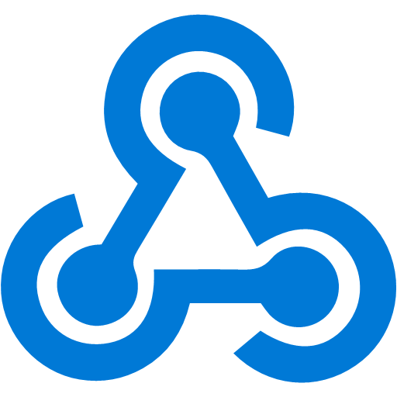

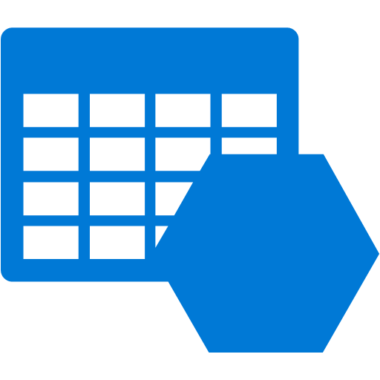


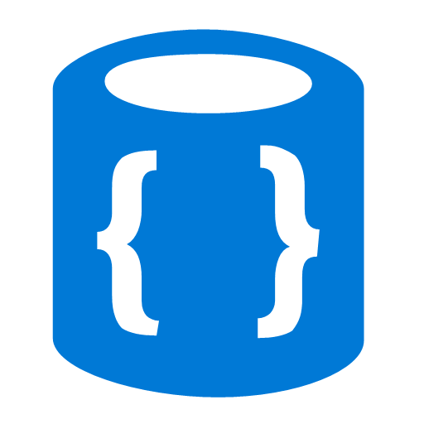

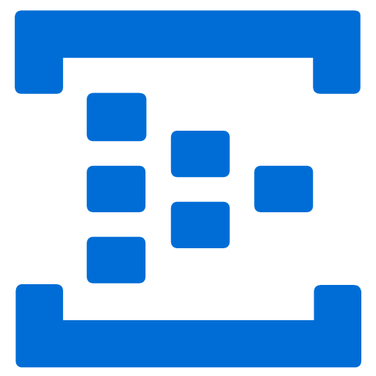
Azure Functions
Events
Code
Outputs
React to timers, HTTP, or events from your favorite Azure services, with more on the way
Author functions in C#, F#, Node.JS, Java, and more
Send results to an ever-growing collection of services

Slide 10

Demo Time

Slide 11
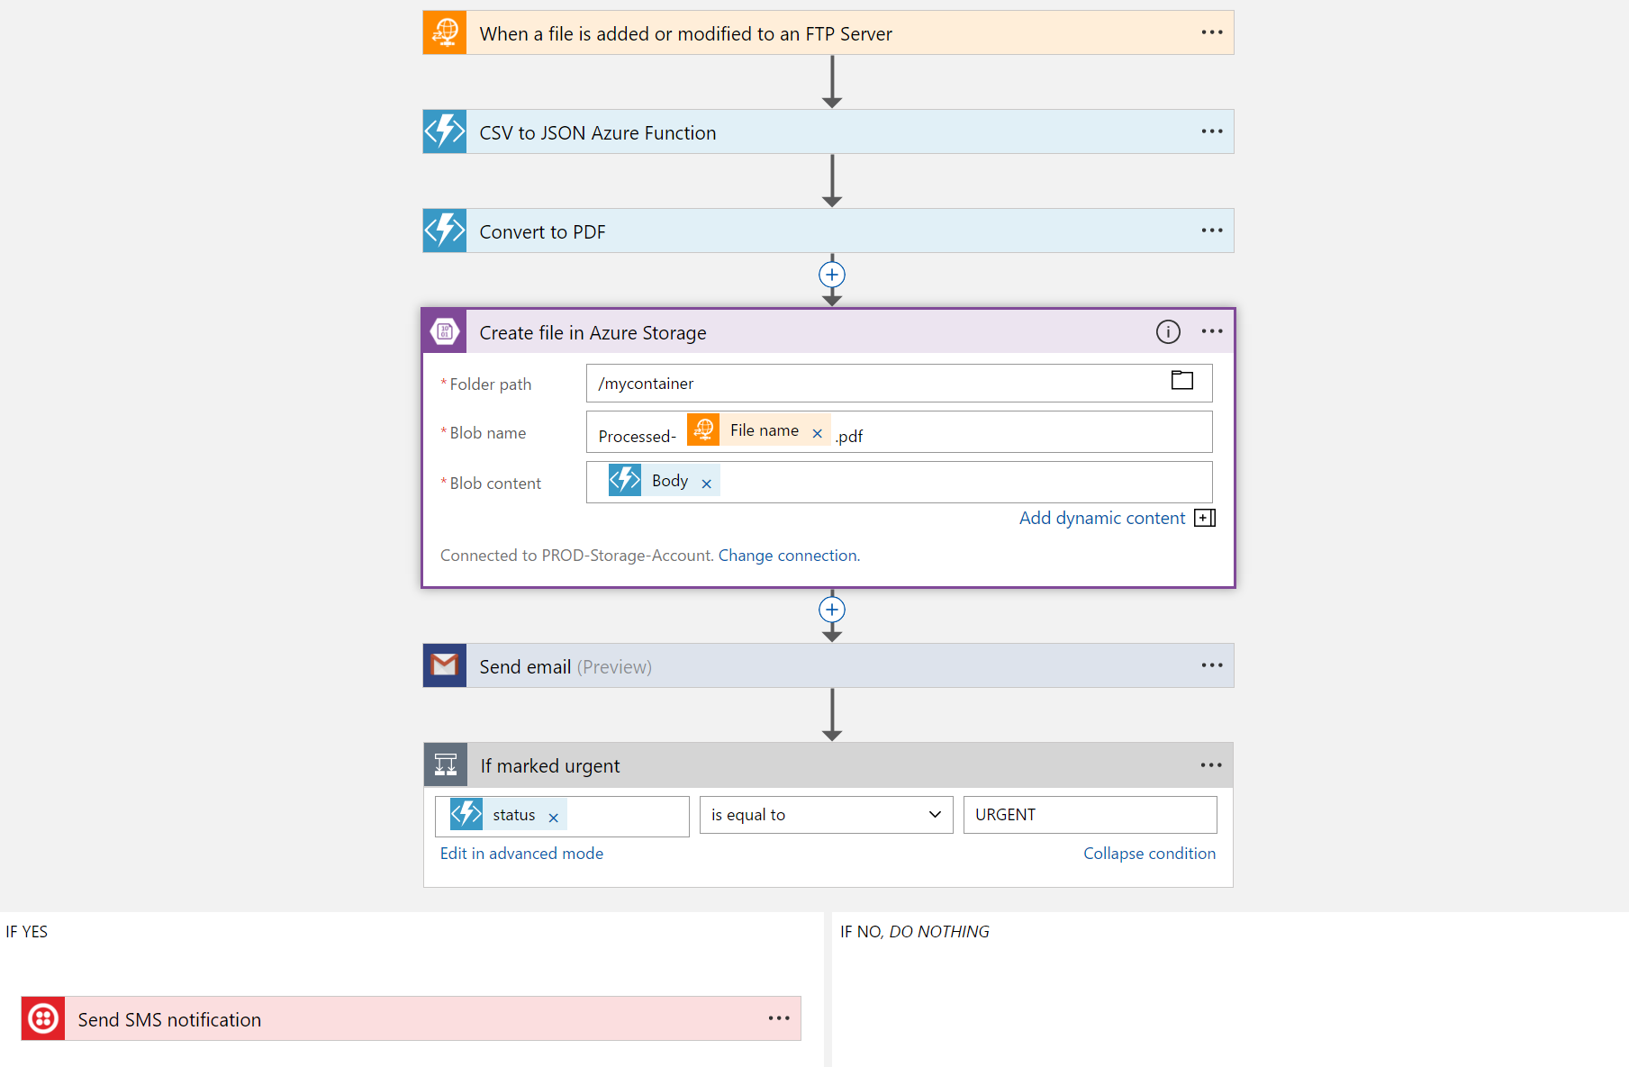
Logic Apps
Visually design workflows in the cloud
Express logic through powerful control flow
Connect disparate functions and APIs
Utilize declarative definition to work with CI/CD
Notes:
Moving on to Logic Apps
Logic Apps is a service that provides a visual design experience for creating serverless workflows in the cloud without writing any code.
No matter how complex your business logic is, you can express it using the powerful control flow available in Logic Apps.
Another key value of this service is that, it provides connections with multiple services and allows you to orchestrate all these services along with the functions which you or someone else in your organization might have written.
Lastly all of these workflows are internally represented using a declarative definition format, again making it very friendly with your existing CI/CD practices

Slide 12


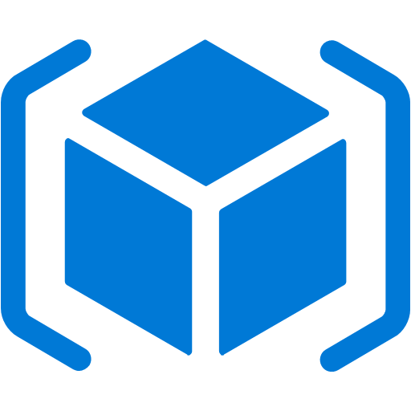

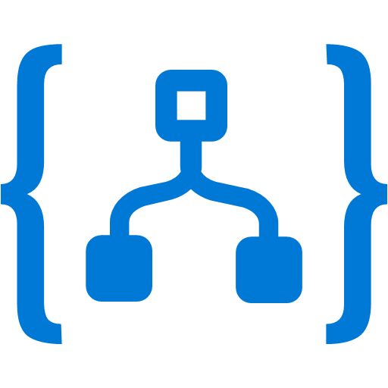
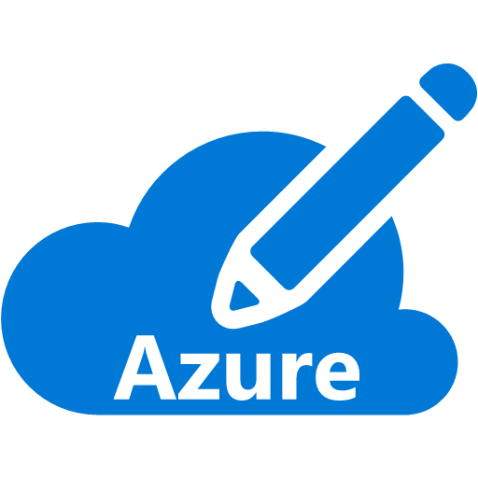


Event Grid
Event publishers
Event handlers
Manage all events in one place
Focus on innovation and pay per event
Unlock new scenarios for your apps
Ensure reliability and performance for your apps
Blob Storage
Azure Functions
Resource Groups
Logic Apps
Azure Subscriptions
Azure Automation
Event Hubs
WebHooks
Custom Events
Notes:
Now, I would like to describe the capabilities of our core serverless services, in a little more detail, this time starting with Azure Event Grid.
We already talked about how important events are.
This service allows you to manage all events in a single place
Notice that multiple Azure services today publish their events into Event Grid and these events can be routed to multiple destination. We have Functions, Logic Apps and even other services like Automation and generic webhooks.
You can also create your own customer events
The rich set of publishers and consumers opens up many interesting scenarios for you to construct already. And the list of services that will publish their events to Event Grid will continue to grow over time.

Slide 13





Azure DevOps
Formally Visual Studio Team Services (VSTS)
Formally Team Foundation Server
Azure Boards
Deliver value to your users faster using proven agile tools to plan, track, and discuss work across your teams.
Azure Pipelines
Build, test, and deploy with CI/CD that works with any language, platform, and cloud. Connect to GitHub or any other Git provider and deploy continuously.
Azure Repos
Get unlimited, cloud-hosted private Git repos and collaborate to build better code with pull requests and advanced file management.
Azure Test Plans
Test and ship with confidence using manual and exploratory testing tools.
Azure Artifacts
Create, host, and share packages with your team, and add artifacts to your CI/CD pipelines with a single click.

Slide 14
Demo Time

Slide 15
Sam Cogan
Solution Architect – Willis Towers Watson
Microsoft Azure MVP
samcogan.com
@samcogan
sam-cogan

